Slide 1
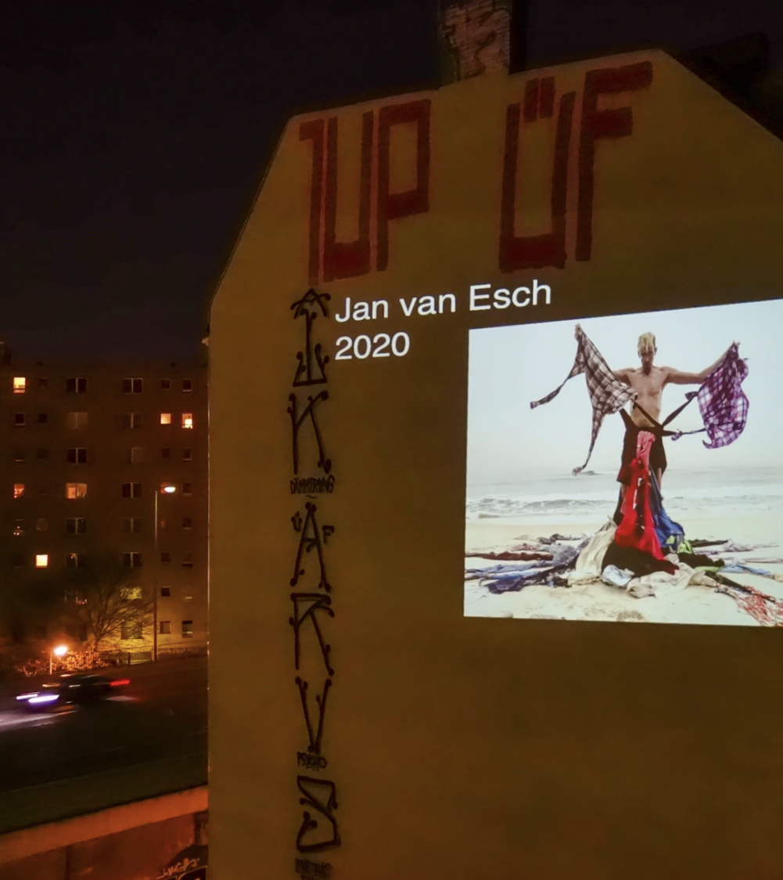
Projection Mapping Guerrilla Mapping

Slide 2
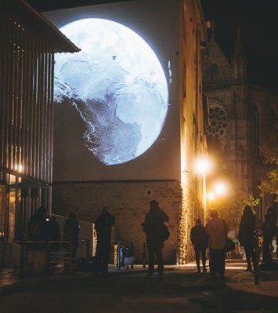
Guerrila projection
Guerrilla projection mapping, also known as out-of-home advertising and urban projections, involves using projectors to display images, animations, or videos onto various surfaces in public spaces without formal authorization or permits
Guerrilla projections have become a popular, practical, and sometimes spectacular way to put forward a political or environmental message. Projections are an effective and often inexpensive way to broadcast inspirational ideas and enhance planned actions.

Slide 3
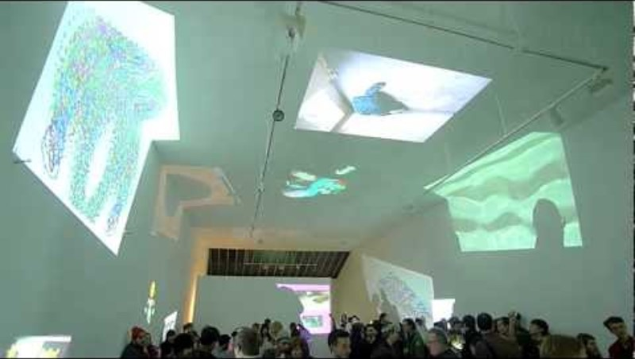
BYOB Or Bring your Own Beamer

Slide 4
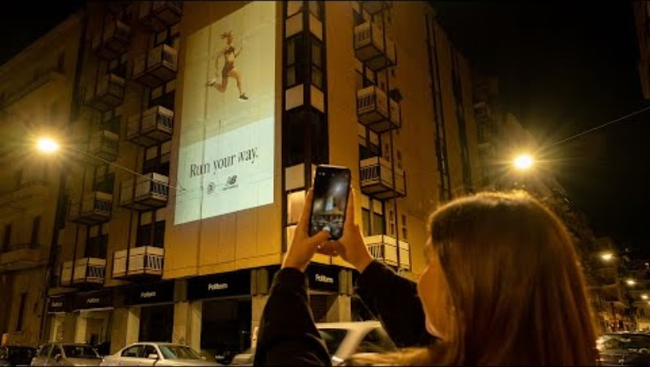

Slide 5
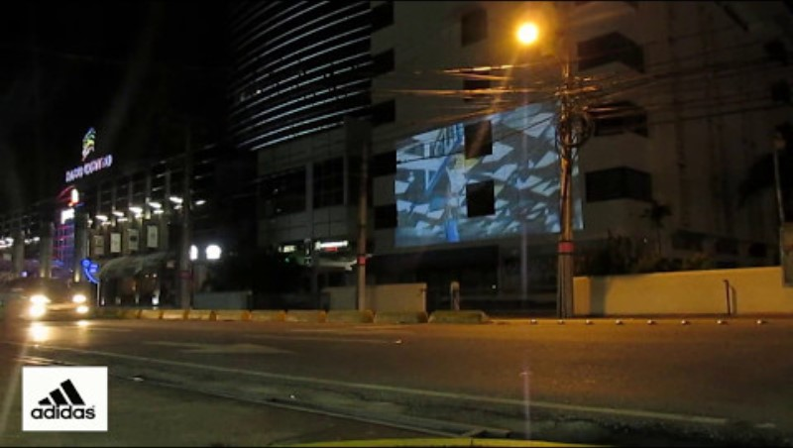

Slide 6
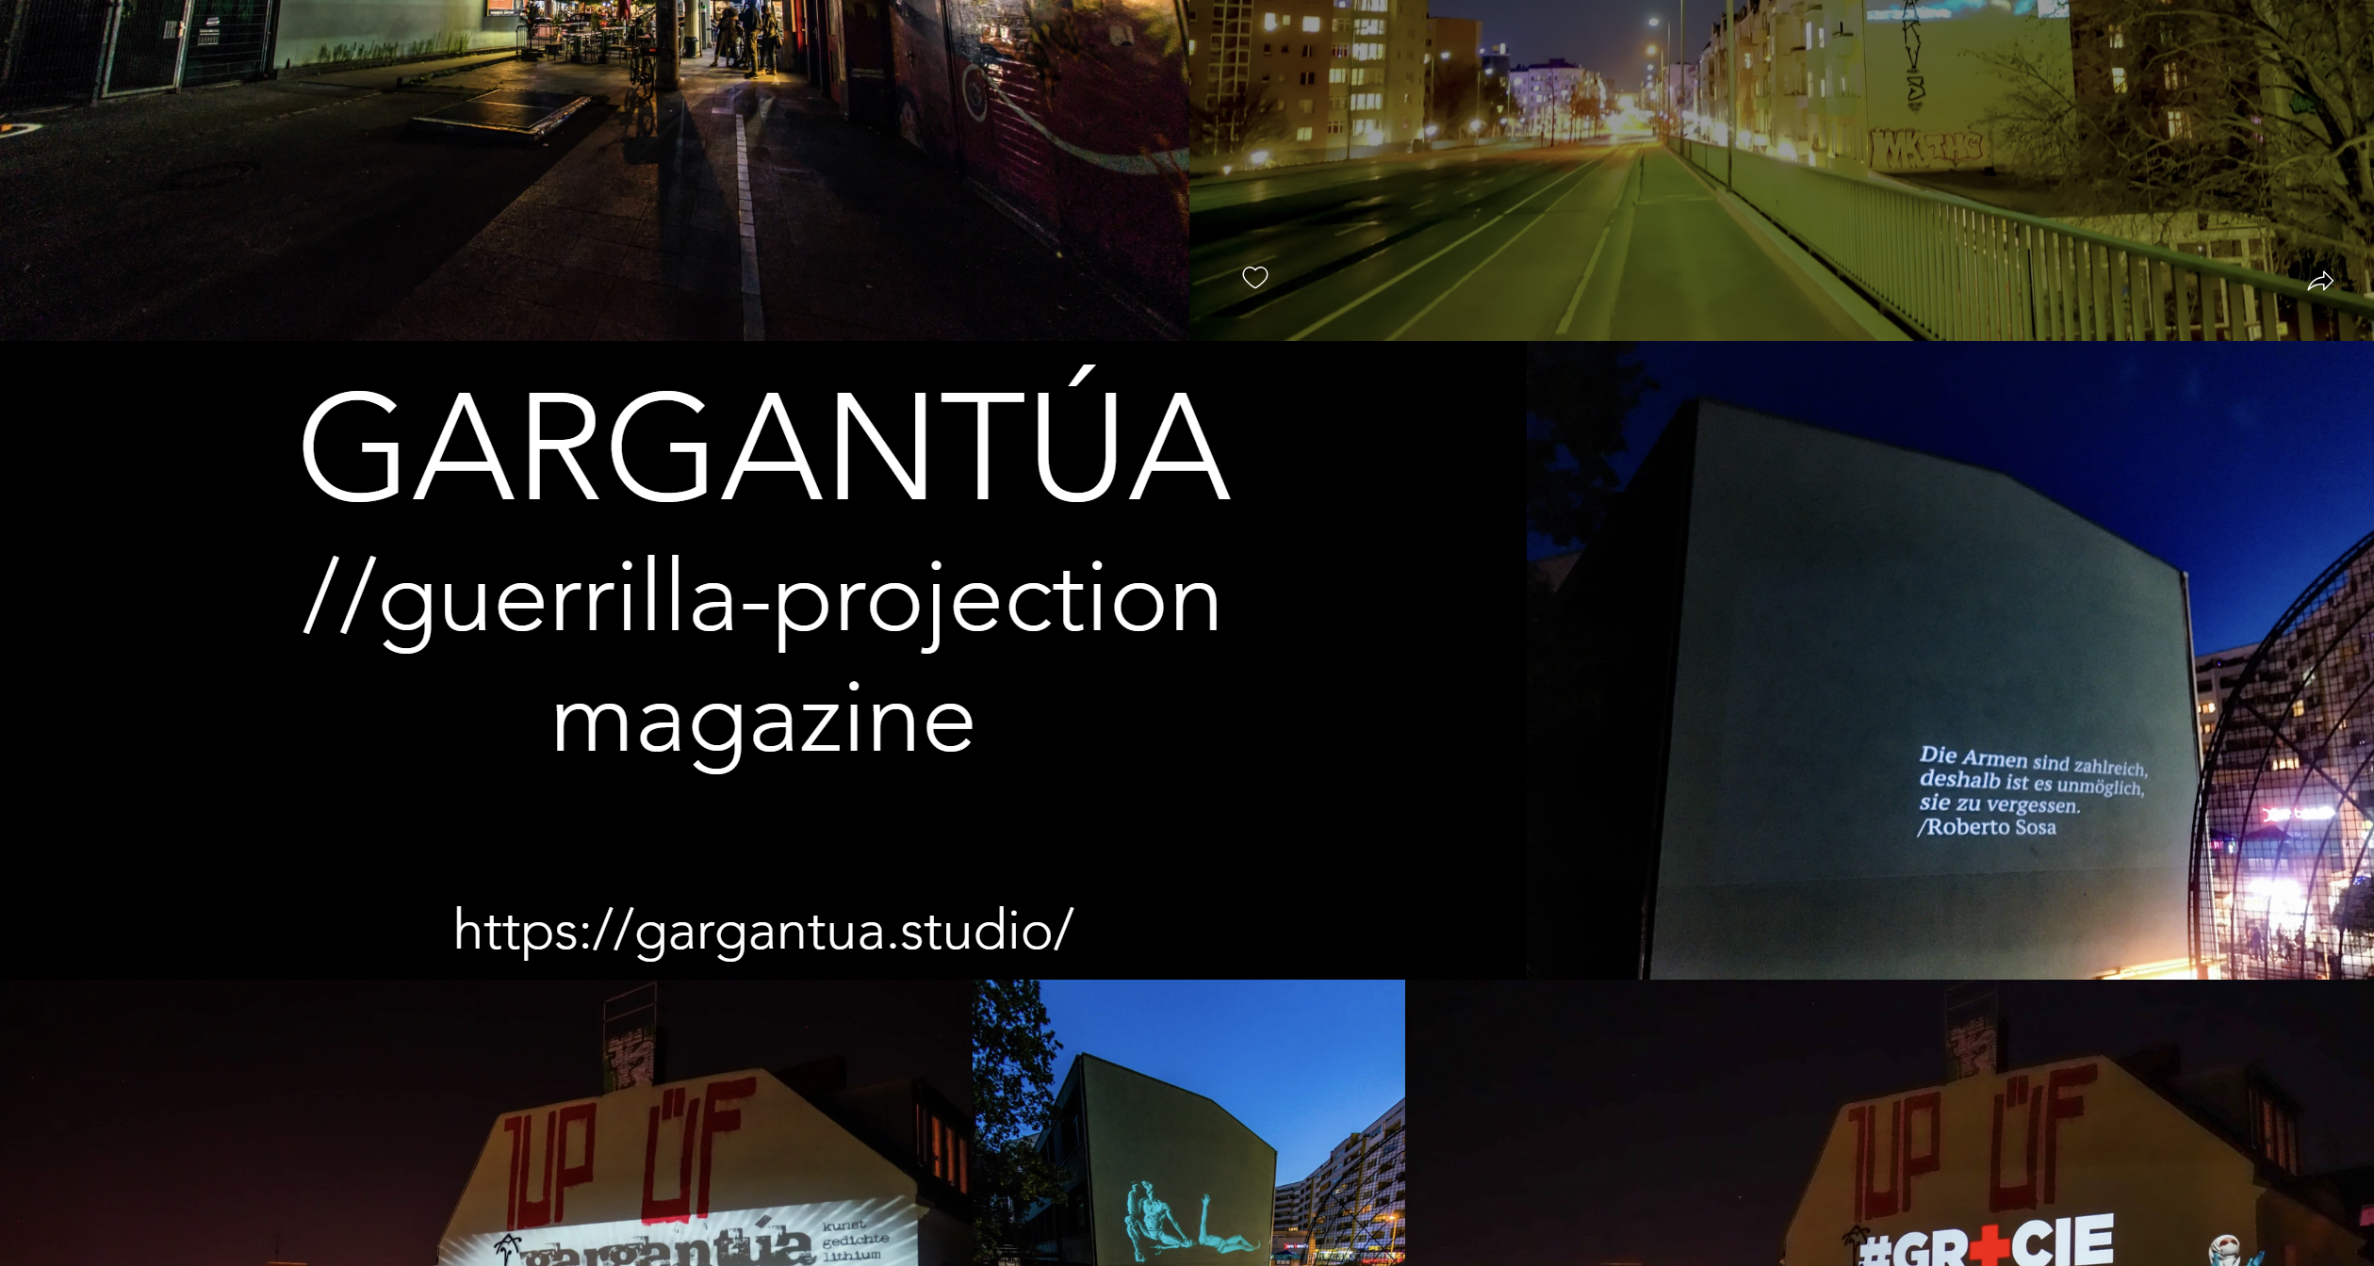
Gargantua

Slide 7
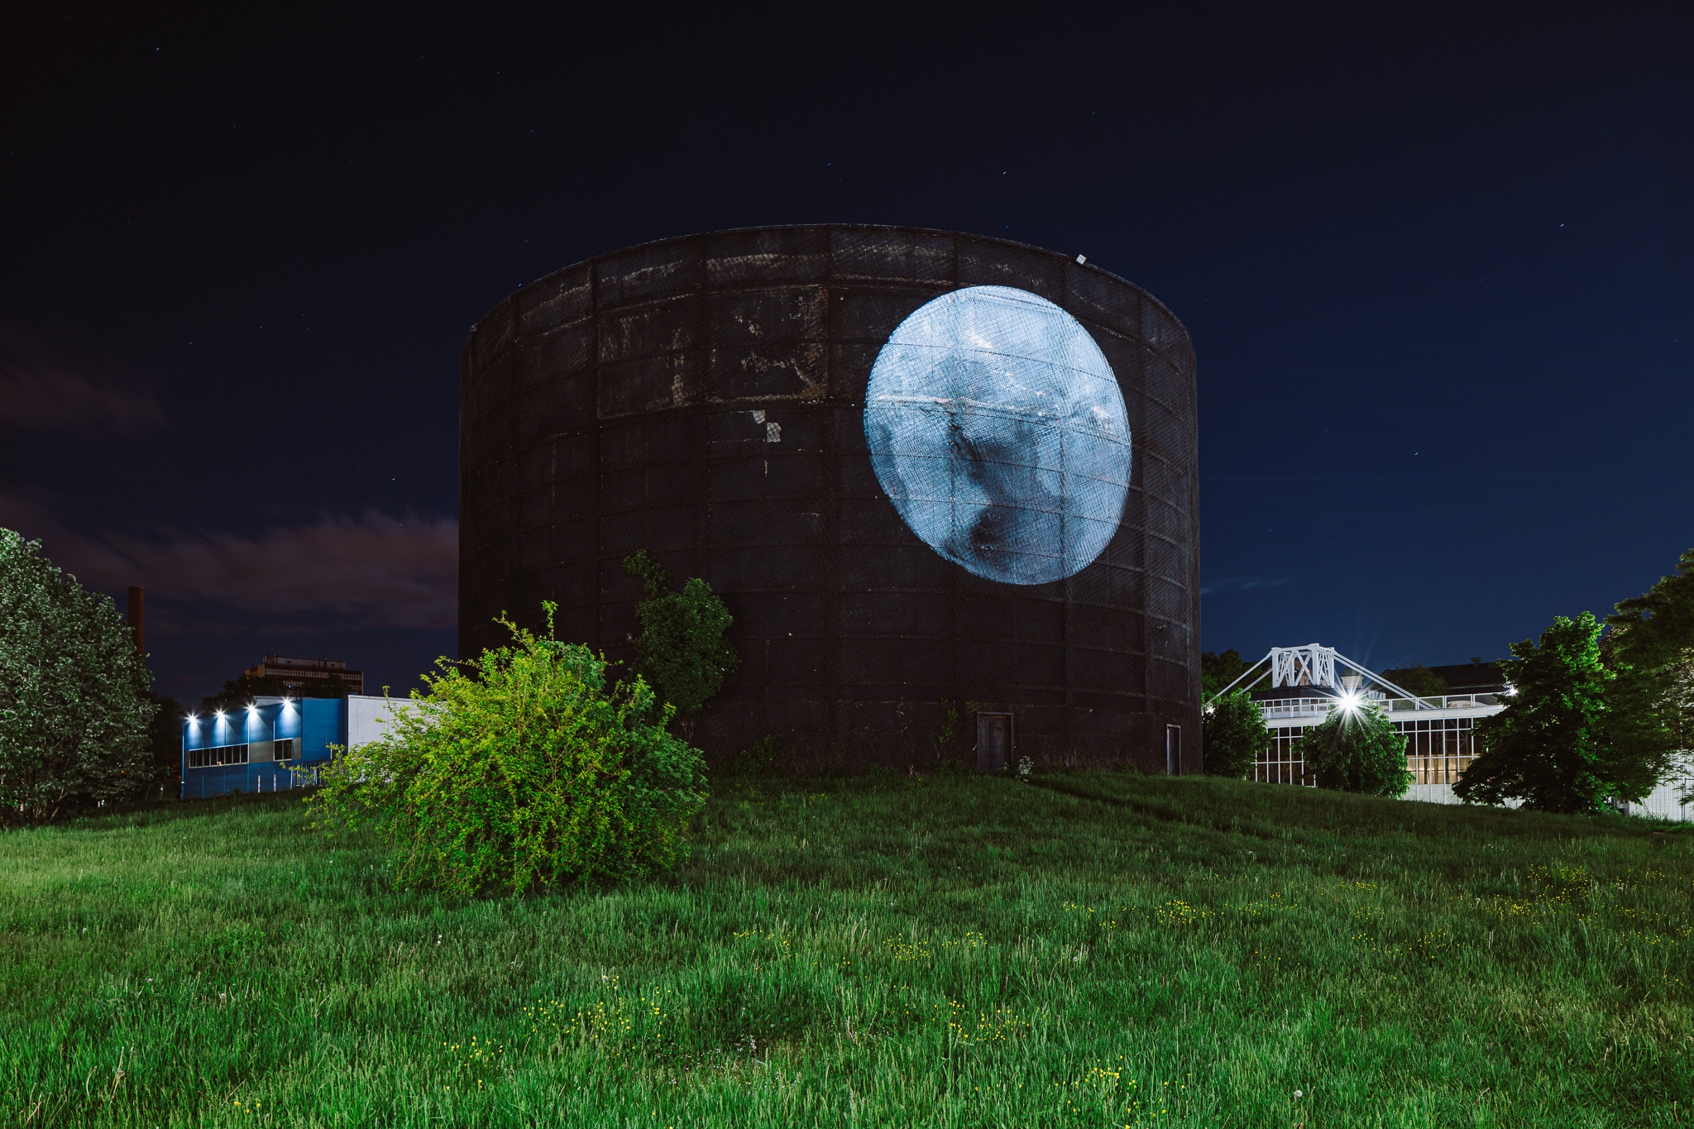

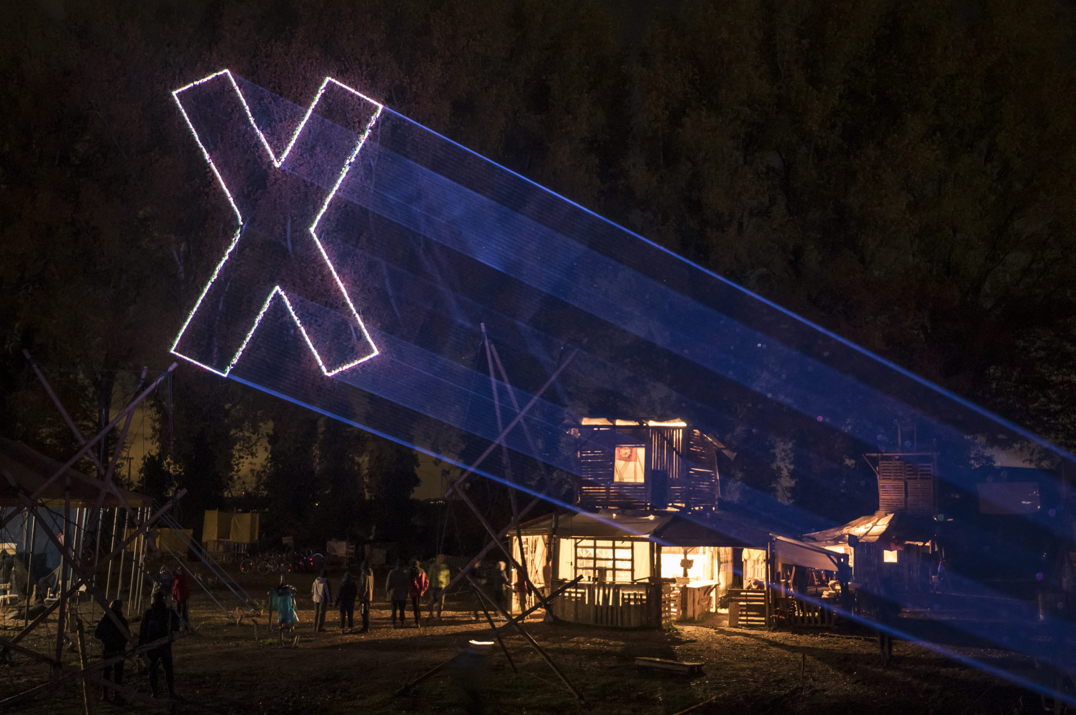
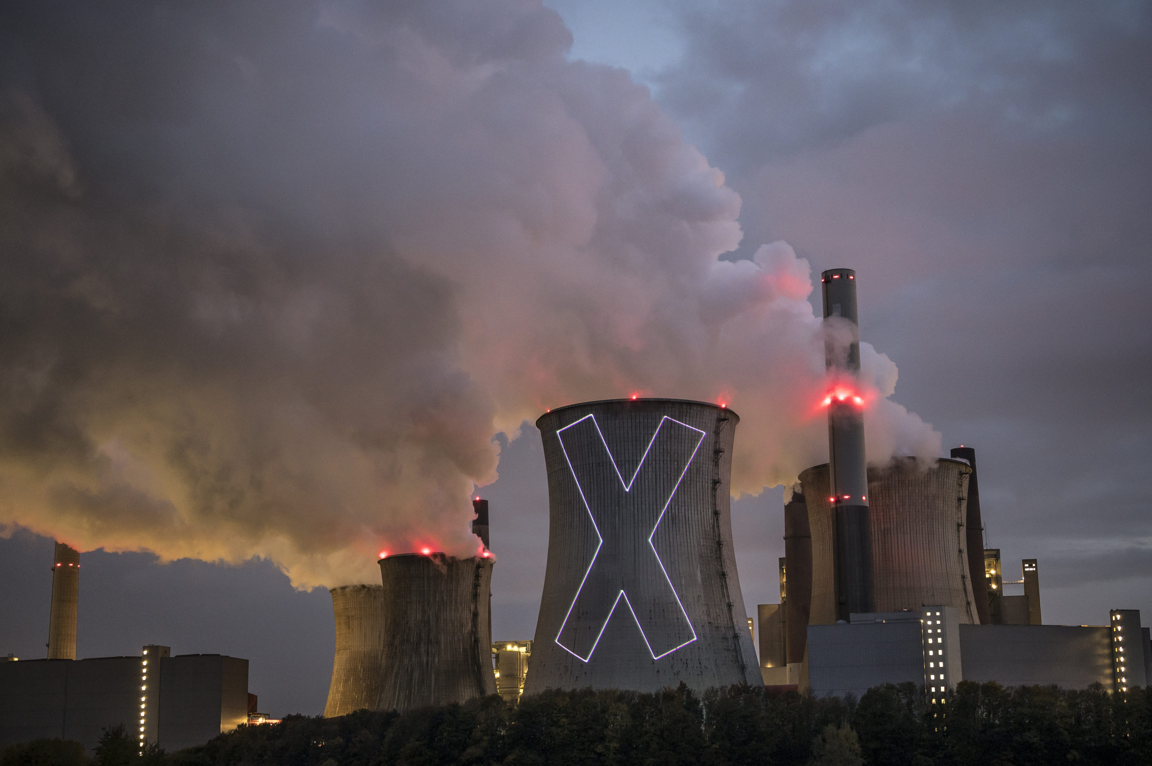
Joannie Lemancier

Slide 8
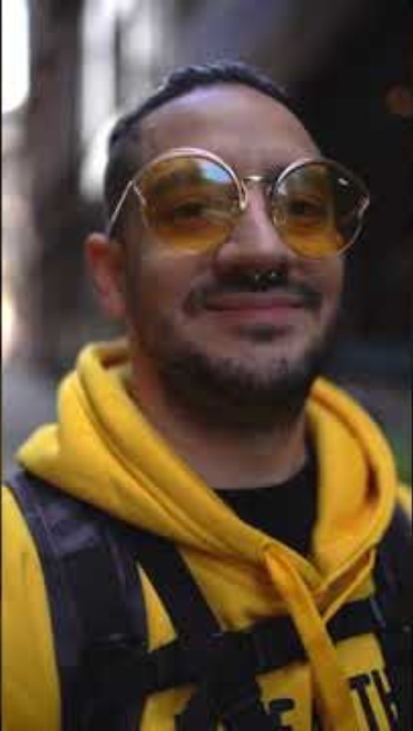
Elephant Stars

Slide 9
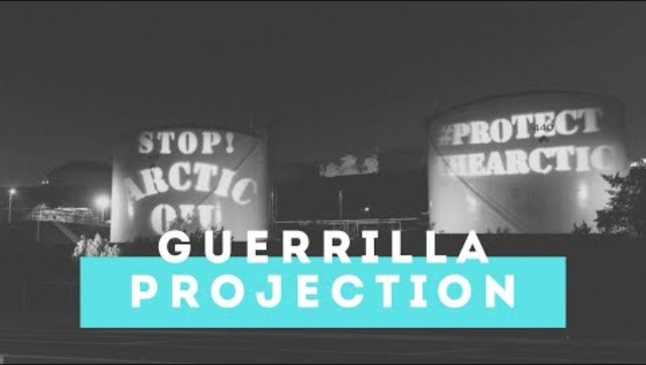
Extinction Rebellion

Slide 10
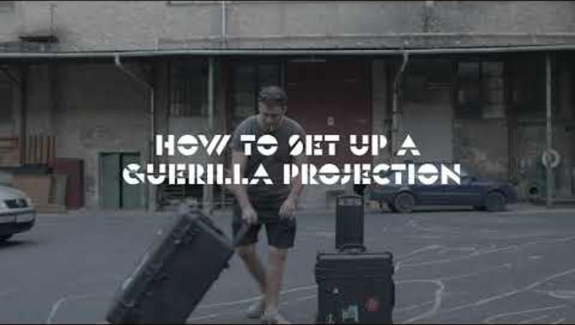

Slide 11
Points to keep in mind
Prepare your content beforehand:
Simple content goes better; you may have to move quickly; hence, it has to bring the message fast.
High contrast works beter
Think about the physical things you will need:
Power cables, projector cables, something to position the projector, etc
Fast Mapping works better:
Doing some simple mapping draws more attention than just bold projection. It shows purpose.
Still keep it quick.
DO test everything before going out.
DON'T knock or bump a projector while it’s on, as non-LED projectors, which is most, is the easiest way to kill a bulb.

Slide 12
Challenge

Slide 13
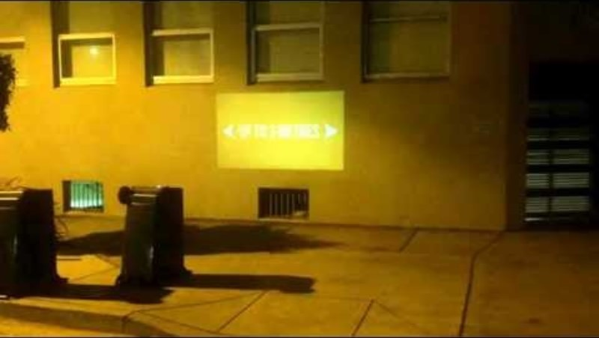

Slide 14
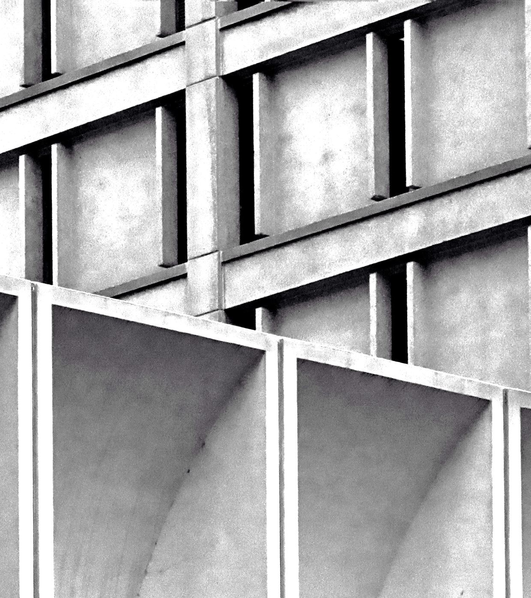
Challenge 4
Do a guerilla (art) projection at the campus. Go around the buildings and project in at least 6 different (public) locations.
Post pictures on the WhatsApp group of the minor.
Keep it simple but try to bring the architectural elements into your work.
Follow the guidelines to avoid trouble
Come back at 15:00

Slide 15
Guidelines
Keep it safe!!
Do not block evacuation routes.
Do not disturb other classes.
Be respectful to staff, teachers and other students.
Be collaborative or asked to move.
Be careful with the projectors; e.g. let them cool down, do not drop them
Leave no trace!
Enjoy and have fun!

Slide 16

Thank you

